Slide 1
Weather & Hike Trails Web App
- Shweta Korulkar
- Harsha Ramayanam

Slide 2
Weather Dashboard
Check weather of any location.
Get 5 days forecast of any location
Check weather and check for a hike.

Slide 3
Features
Search weather by City Name.
Geo location
Get 5 days weather forecast
Get 24 hours weather information of given location.
Link to home page and hike page
Changing background image according to weather condition.

Slide 4
Stack
FRONT END → HTML5, CSS3, JAVASCRIPT, ReactJS
BACK END → Node.js, REST API’s
API used: OpenWeatherMap API

Slide 5
Major problem encountered
Difficulty with displaying background image according to weather condition.
Tried using getElementById to display background image but didn’t worked.
Difficulty displaying forecast.

Slide 6
Solution
Used style attribute to set background image according to weather condition.
Used props to display forecast data.

Slide 7
Future work
More information about weather like UV index, humidity, pressure etc.
National weather alert message.
Weather map

Slide 8
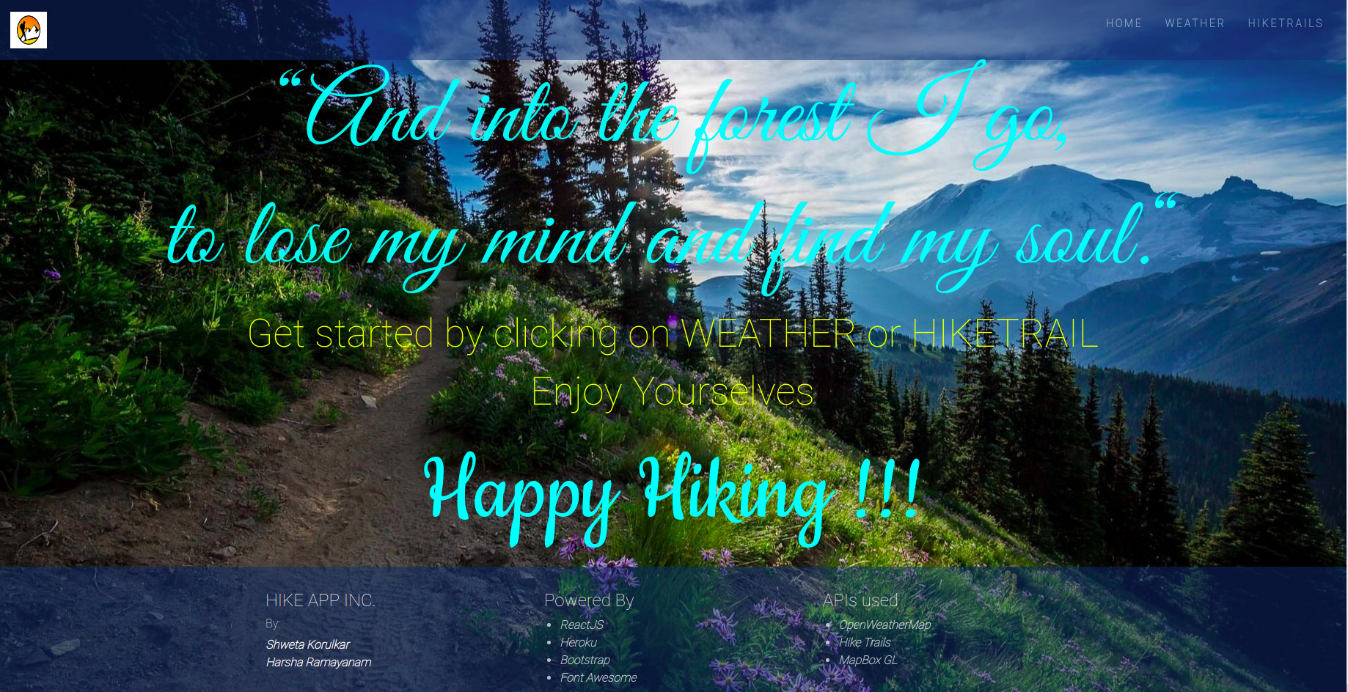
Demo- Home page

Slide 9
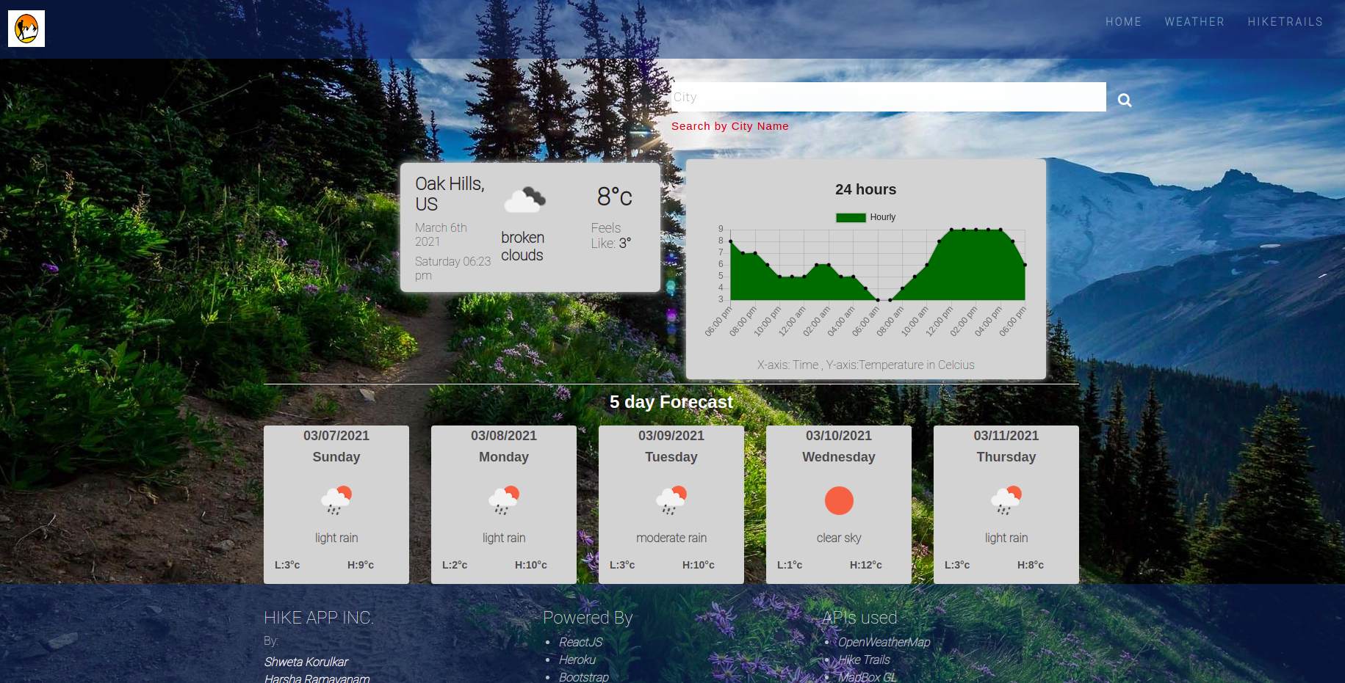
Demo - geolocation feature

Slide 10
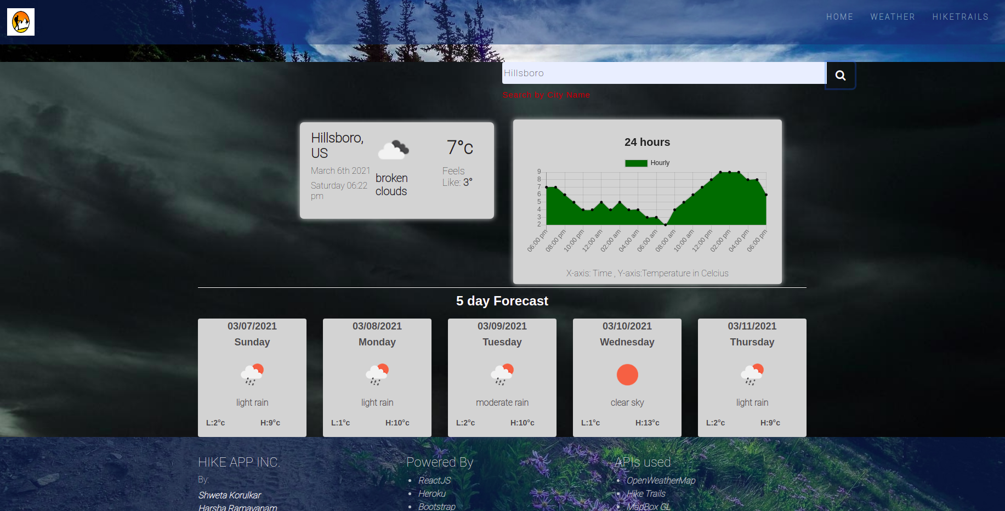
Demo – Search by City Name

Slide 11
Hiking
Search for various hikes present in the US.
More narrowed searched available.
Learn more stats of a hike.

Slide 12
Features
Various search options.
Results filtered by user input.
Various stats displayed with descent UI.
Get Directions based on geolocation.
Check weather at that hike location.

Slide 13
Stack
FRONT END → HTML5, CSS3, JAVASCRIPT, ReactJS
BACK END → Node.js, REST API’s
API used: MapBoxGL API, All Hike-trails dataset.

Slide 14
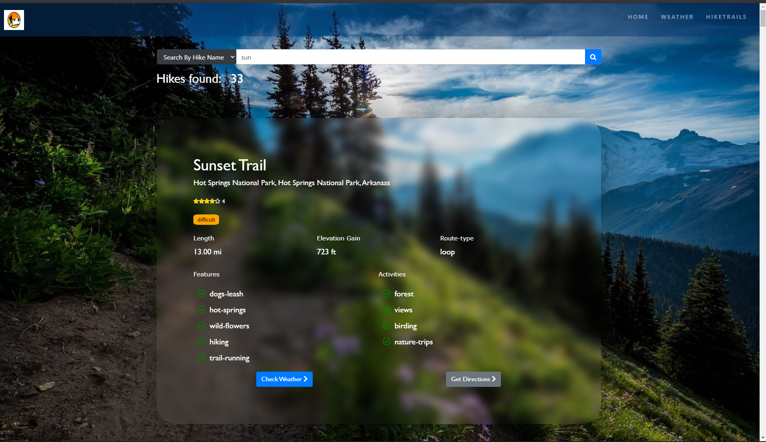
Demo – Search by hike name

Slide 15
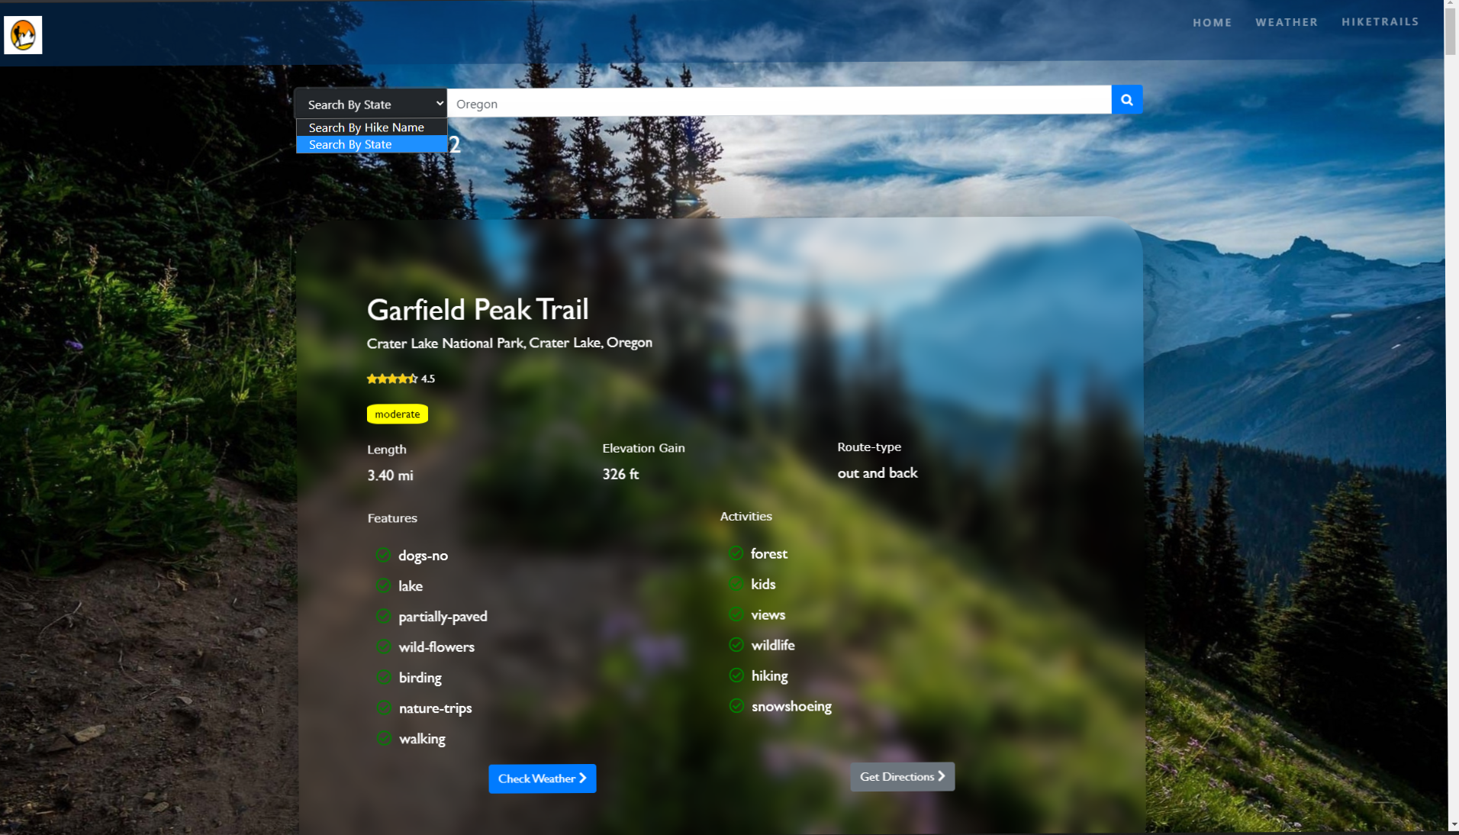
Demo – Search by State

Slide 16
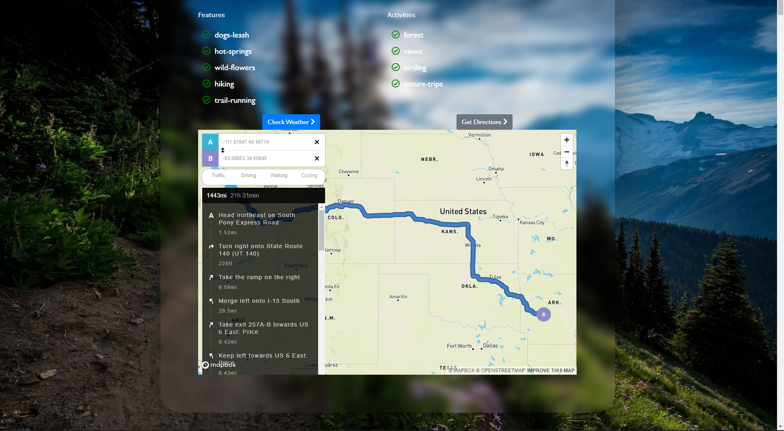
Demo – Get directions

Slide 17
Major problems encountered
Hike Trail dataset.
Footer not staying at the bottom if page has less content.
Difficulty in displaying star-ratings for a hike.
Encountered problems with passing prop variables to parent components.

Slide 18
Solution
Dataset from Kaggle.
Fixed the footer problem with a simple CSS flexbox trick.
Fixed the calculation for star-rating and displaying styles for them as inline-styles.
Fixed passing prop variables to any React component using useContext hook.

Slide 19
Future work
Add some more stats for hikes.
Create User accounts.
Connect a DB to add new hikes.
Display messages “open” / “closed” due to COVID situation.

Slide 20
LIVE DEMO

Slide 21
Any Questions?

